Slide 1
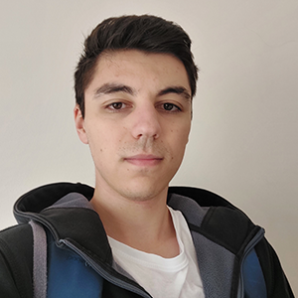
Erik Baliov
Android Developer at Carista
Transforming Your Android Device into an IP Camera

Slide 2
Camera2 API

Slide 3
Camera2 API
CameraManager
CameraDevice
CaptureRequest
CaptureSession

Slide 4
Camera devices
Characteristics
Camera Manager
Camera Manager
Системен клас за откриване, характеризиране и свързване към камери.
Open Camera

Slide 5
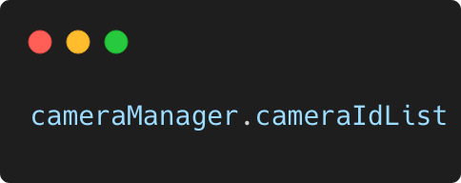
Camera devices
Characteristics
Camera Devices
Camera Manager
Open Camera

Slide 6
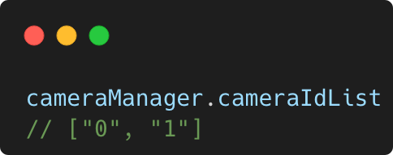
Camera devices
Characteristics
Camera Devices
Camera Manager
Open Camera

Slide 7
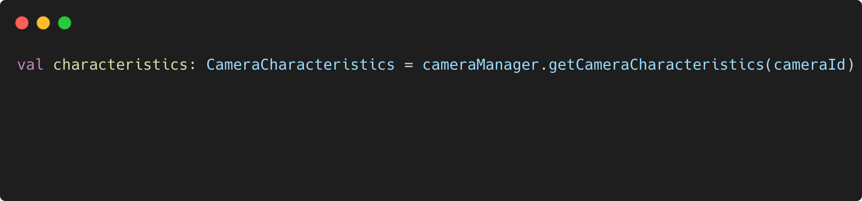
Camera devices
Characteristics
Camera Characteristics
Camera Manager
Open Camera

Slide 8
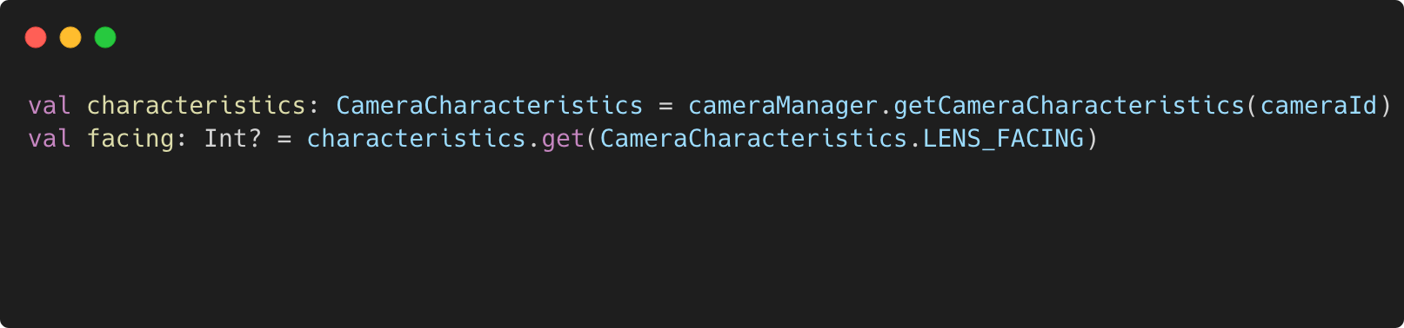
Camera devices
Characteristics
Camera Characteristics
Camera Manager
Open Camera

Slide 9
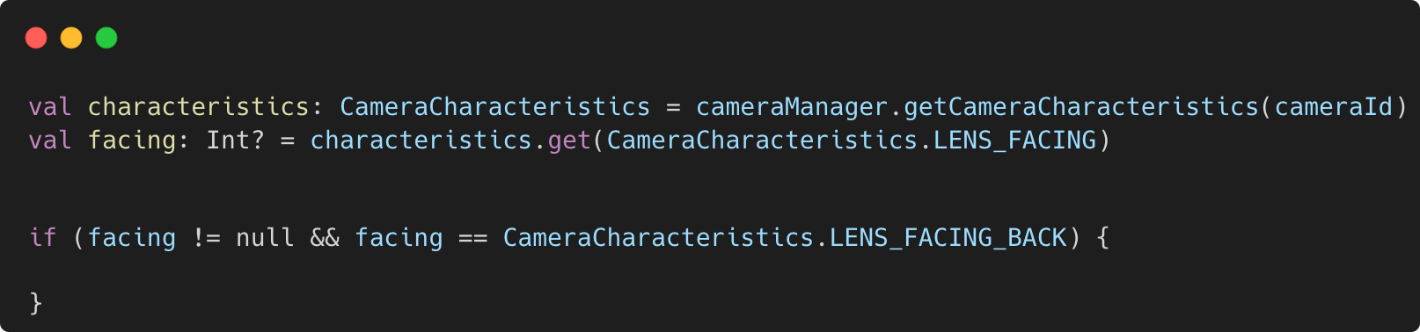
Camera devices
Characteristics
Camera Characteristics
Camera Manager
Open Camera

Slide 10
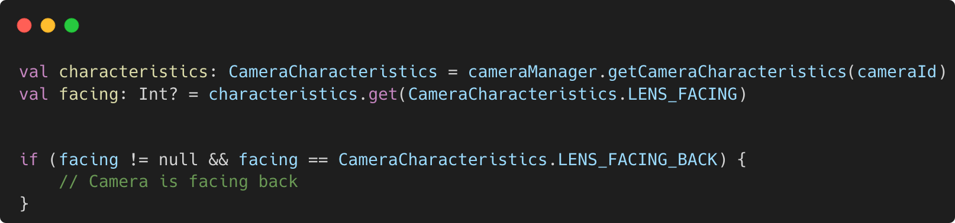
Camera devices
Characteristics
Camera Characteristics
Camera Manager
Open Camera

Slide 11
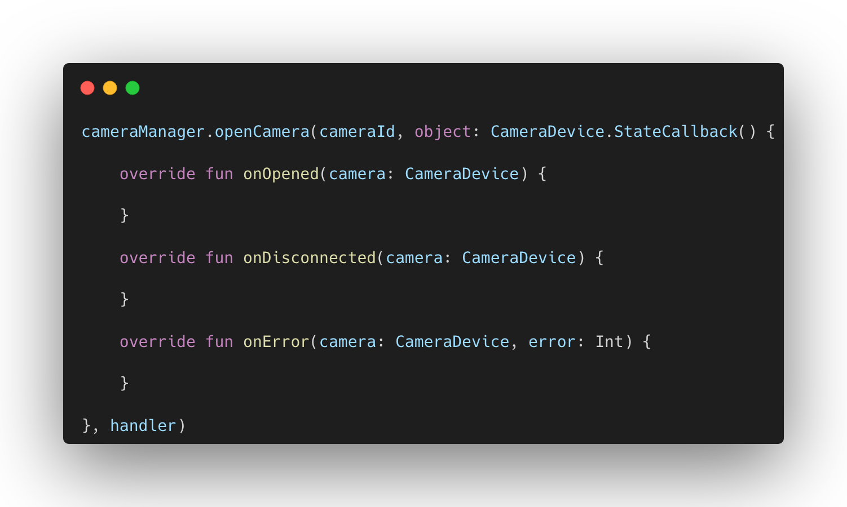
Camera devices
Characteristics
Open Camera
Camera Manager
Open Camera

Slide 12
Capture Request
Capture Session
Camera Device
Camera Device

Slide 13
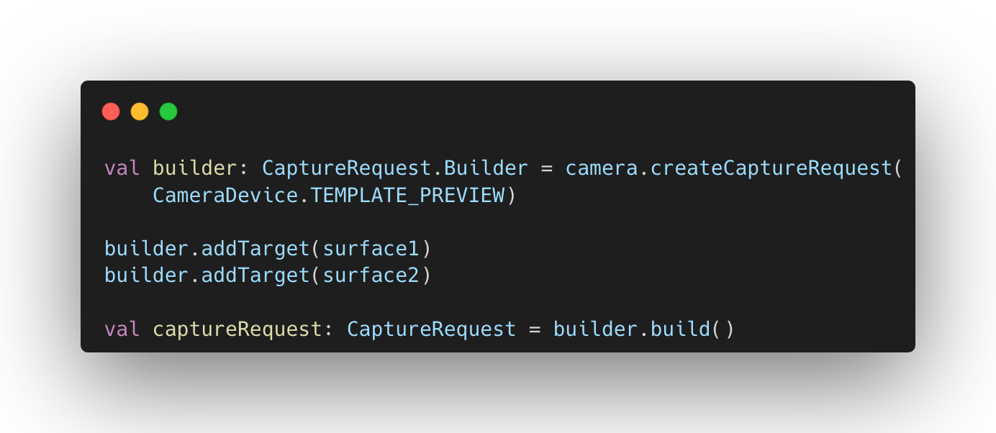
Capture Request
Capture Session
Capture Request
Camera Device

Slide 14
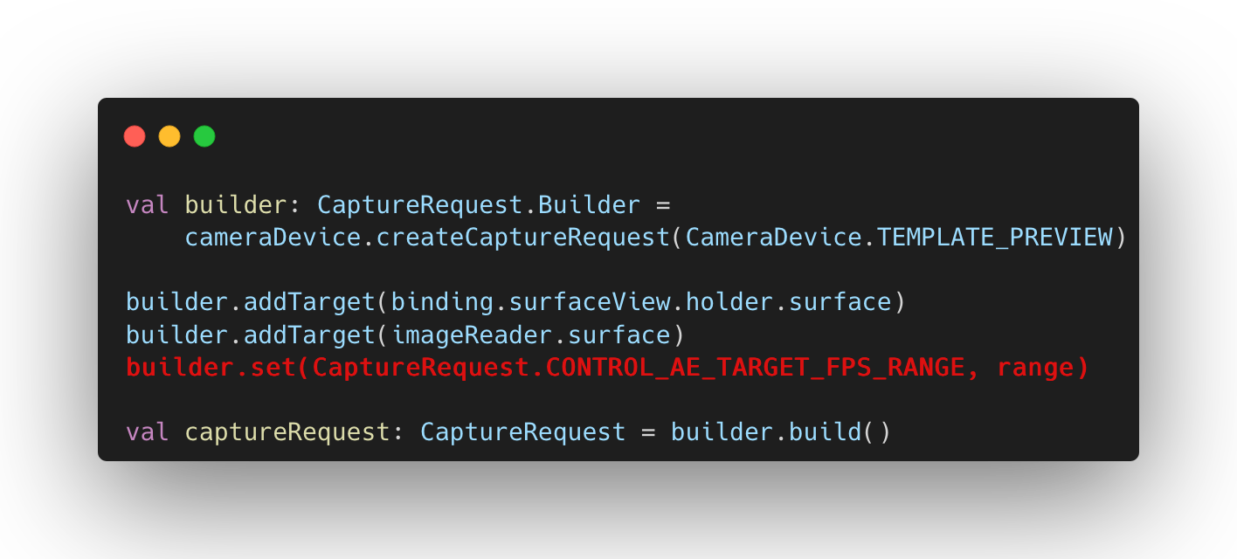
Capture Request
Capture Session
Capture Request
Camera Device

Slide 15
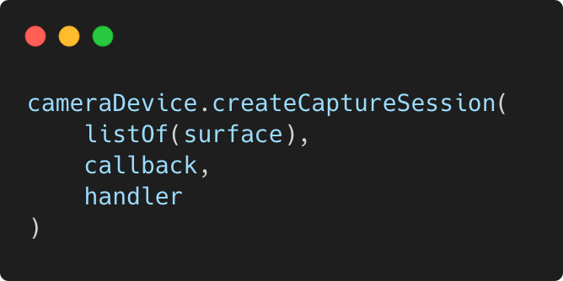
Capture Request
Capture Session
Capture Session
Camera Device

Slide 16
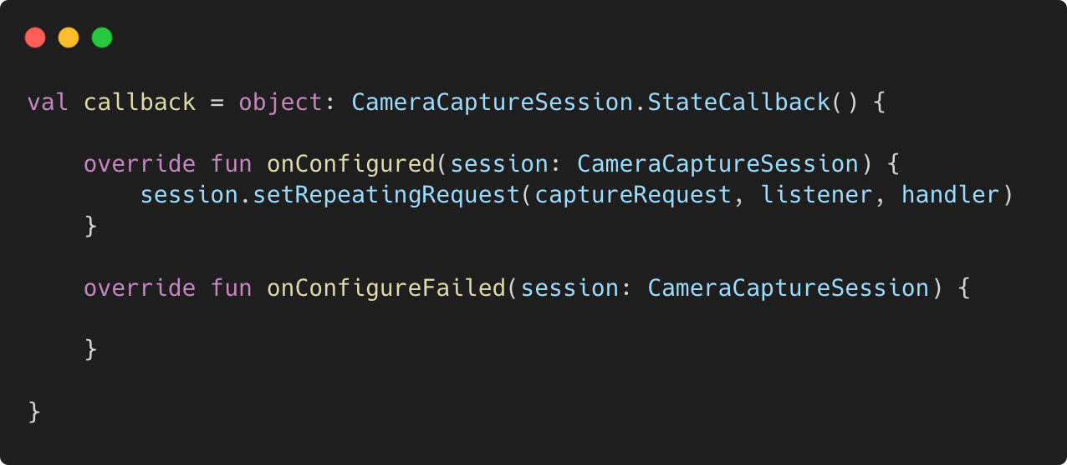
Capture Request
Capture Session
Capture Session
Camera Device

Slide 17
Sockets
Datagram sockets
Stream sockets

Slide 18
Datagram socket (UDP)
Connectionless
Unreliable
Order is not guaranteed
Lightweight

Slide 19
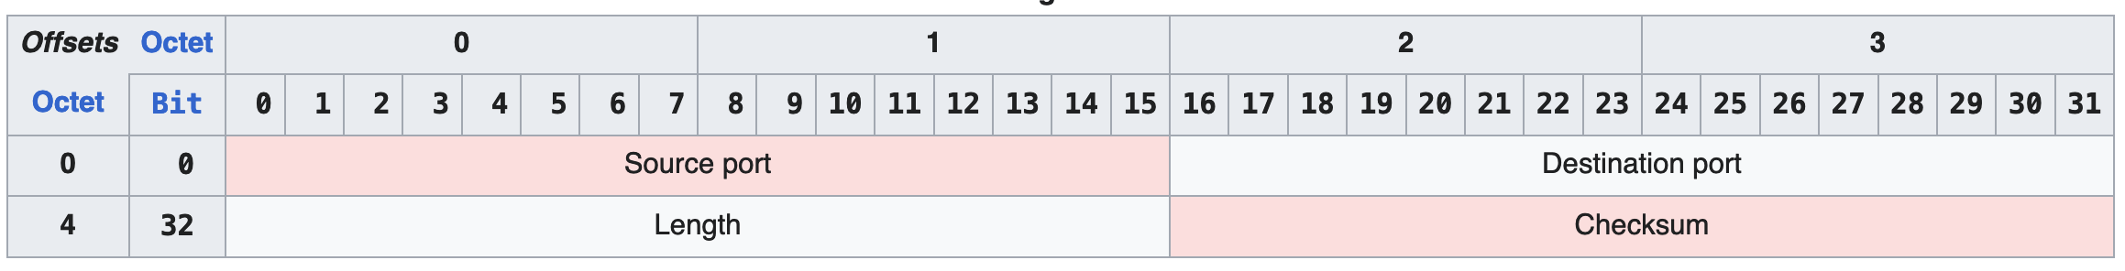
Datagram socket (UDP)

Slide 20
Datagram socket (UDP)
Side A
Side B
4
1
1
4
3
2
2

Slide 21
Stream sockets (TCP)
Connection-oriented
Reliable
Order is guranteed
Heavyweight

Slide 22
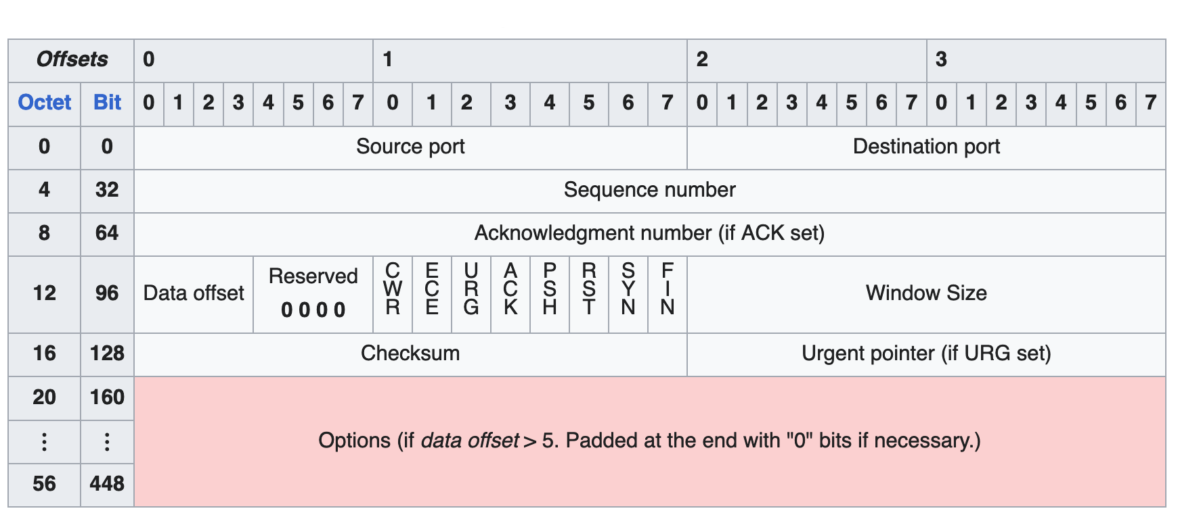
Stream sockets (TCP)

Slide 23
Stream sockets (TCP)
Server
Client
SYN
SYN-ACK
ACK

Slide 24
Demo

Slide 25
Q&A

Slide 26


Contacts:
in/baliofvfx
/BalioFVFX

